Slide 2
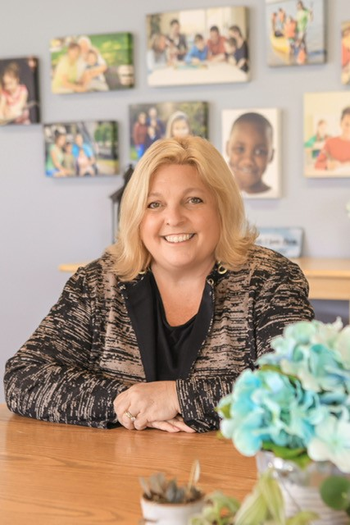
Welcome!
Aimee Beam, MS, CNP, CFRM

Slide 3
Joyous Fundraising For Nonprofit Leaders
Learn the JOY System

Slide 4
Nonprofits Need
Resources and
Funding

Slide 5
Fundraising evokes feelings of dread and hopelessness

Slide 6
What if those negative feelings could be replaced with a sense of peace and Joy?

Slide 7
What Can We
Accomplish For Our Mission?

Slide 8
Learn The JOY System

Slide 9
Learning The JOY System
For development and non-development staff alike
No experience necessary!

Slide 10
Learning The JOY System
Raise money without fear or anxiety

Slide 11
It Begins With The
J

Slide 12
Examine The Journey You Are On…

Slide 13
What Are Your Personal Goals?

Slide 14
What Is Your Mission?

Slide 15
The Next Letter Is
O

Slide 16
Each Person Has Options for Fundraising

Slide 17
Consider Your Personal Comfort Level

Slide 18
Assess Your Knowledge and Background

Slide 19
Examine Your Personality Type

Slide 20
The Next Letter Is
Y

Slide 21
Combine The Inputs to make a plan that fits YOU
Combine The Inputs for a Plan That Fits YOU

Slide 22
Authenticity Leads YOU
to a YES

Slide 23
The Research On Joy

Slide 24
Conclusion
Once people feel comfortable being their authentic selves in a fundraising space they feel empowered and joy-filled with each interaction.
This leads to more activity which quickly increases results!

